Slide 1
Strings in Python

Slide 2
Check Validity of a PAN
In any of the country's official documents, the PAN number is listed as follows
<alphabet>< alphabet> < alphabet > < alphabet >
< alphabet > <digit><digit><digit><digit>< alphabet >
Your task is to figure out if the PAN number is valid or not. A valid PAN number will have all its letters in uppercase and digits in the same order as listed above.

Slide 3
PAC For Chocolate Problem
Input | Processing | Output
PAN number | Take each character and check if alphabets and digits are appropriately placed | Print Valid or Invalid

Slide 4
Pseudocode
READ PAN
If length of PAN is not ten then print “Invalid” and exit
FOR x=0 to5
if PAN[x] is not a character THEN
PRINT ‘invalid’
BREAK;
END IF
END FOR
FOR x=5 to 9
if PAN[x] is not a digit THEN
PRINT ‘invalid’
BREAK;
END IF
END FOR
IF PAN[9] is not a character THEN
PRINT ‘invalid’
END IF
PRINT ‘valid’

Slide 5
Test Case 1
abcde1234r
Valid

Slide 6
Test Case 2
abcde12345
Invalid

Slide 7
Test Case 3
abcd01234r
Invalid

Slide 8
Strings
Immutable sequence of characters
A string literal uses quotes
'Hello' or "Hello“ or ‘’’Hello’’’
For strings, + means “concatenate”
When a string contains numbers, it is still a string
We can convert numbers in a string into a number using int()

Slide 9
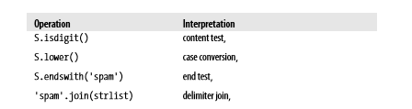
String Operations

Slide 10
Example Strings
Single quotes: 'spa"m'
Double quotes: "spa'm"
Triple quotes: '''... spam ...''', """... spam ..."""
Escape sequences: "s\tp\na\0m“

Slide 11
Escape Sequences
Represent Special Characters
>>> s = 'a\nb\tc'
>>> s 'a\nb\tc'
>>> print(s)
a
b c
>>> len(s)
5

Slide 12
Backslash in Strings
if Python does not recognize the character after a \ as being a valid escape code, it simply keeps the backslash in the resulting string:
>>> x = "C:\py\code"
# Keeps \ literally (and displays it as \\)
>>> x
'C:\\py\\code'
>>> len(x)
10

Slide 13
Check this
s = "C:\new\text.dat“
>>>s
print(s)
s1 = r"C:\new\text.dat“
>>>s1
print(s1)
s2 = "C:\\new\\text.dat“
print(s2)
>>>s2

Slide 14
Opening a File
myfile = open('C:\new\text.dat', 'w') - Error
myfile = open(r'C:\new\text.dat', 'w')
Alternatively two backslashes may be used
myfile = open('C:\\new\\text.dat', 'w')
>>> path = r'C:\new\text.dat'
>>> print(path) # User-friendly format C:\new\text.dat
>>> len(path)
15

Slide 15
Basic Operations
>>> 'Ni!' * 4
'Ni!Ni!Ni!Ni!‘
>>> print('-' * 80) # 80 dashes, the easy way
>>> myjob = "hacker"
>>> for c in myjob:
print(c, end=' ')
h a c k e r

Slide 16
Using ‘in’ Operator in Strings
>>> “m" in “myjob” # Found
True
>>> "z" in “myjob” # Not found
False
>>> 'spam' in 'abcspamdef'
# Substring search, no position returned
True

Slide 17
Counting
Count the number of ‘a’
Example
word = 'Btechallbranches'
count = 0
for letter in word :
if letter == 'a' :
count = count + 1
print count

Slide 18
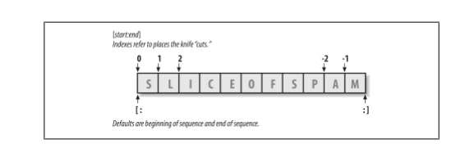
Indexing and Slicing
>>> S = 'spam'
Last character in the string has index -1 and the one before it has index -2 and so on

Slide 19
Indexing and Slicing
Take one letter from a word at a time
Use square bracket and give the index of the letter to be extracted
Indexing can be done either from front or from end
>>> S[0], S[−2]
('s', 'a')

Slide 20
Slicing
Take a part of a word
Square bracket with two arguments with a colon
First value indicates the starting position of the slice and second value indicates the stop position of the slice
Character at the stop position is not included in the slice
>>> S[1:3]
'pa’

Slide 21
Slicing
If the second number is beyond the end of the string, it stops at the end
If we leave off the first or last number of the slice, it is assumed to be beginning or end of the string respectively
s = ‘spam’
>>>s[:3]
‘spa’
>>>s[1:]
‘pam’

Slide 22
Properties of Slicing
S[1:3] - fetches items at offsets 1 up to but not including 3.
S[1:] - fetches items at offset 1 through the end
S[:3] - fetches items at offset 0 up to but not including 3
S[:−1] - fetches items at offset 0 up to but not including last item
S[:] - fetches items at offsets 0 through the end—making a top-level copy of S

Slide 23
Extended slicing
X[I:J:K] - means “extract all the items in X, from offset I through J−1, by K.”
Third limit, K, defaults to +1
If you specify an explicit value it is used to skip items
Extraction is reversed when negative value is given for K-1
Each time K-1 items are skipped

Slide 24
Extended slicing Examples
>>> S = 'abcdefghijklmnop'
>>> S[1:10:2] # Skipping items
'bdfhj'
>>> S[::2]
'acegikmo‘
>>> S = 'hello'
>>> S[::−1] # Reversing items
'olleh'

Slide 25
String Conversion Tools
>>> "42" + 1
TypeError: Can't convert 'int' object to str implicitly
>>> int("42"), str(42) # Convert from/to string
(42, '42')
int("42") + 1
43
>>> "42" + str(1)
'421'

Slide 26
Concatenation
>>>S1 = ‘Welcome’
>>>S2 = ‘Python’
>>>S3 = S1 + S2
>>>S3
'WelcomePython'

Slide 27
Changing Strings
String - “immutable sequence”
Immutable - you cannot change a string in place
>>> S = 'spam'
>>> S[0] = 'x' # Raises an error!
TypeError: 'str' object does not support item assignment
But S = ‘Apple’ works
How??

Slide 28
Changing Strings
>>> S = S + 'SPAM!'
# To change a string, make a new one
>>> S
'spamSPAM!'
>>> S = S[:4] + 'Burger' + S[−1]
>>> S
'spamBurger!'

Slide 29
Replace
>>> S = 'splot'
>>> S = S.replace('pl', 'pamal')
>>> S
'spamalot'

Slide 30
Formatting Strings
>>> 'That is %d %s bird!' % (1, 'dead')
That is 1 dead bird!
>>> 'That is {0} {1} bird!'.format(1, 'dead')
'That is 1 dead bird!'

Slide 31
String Library
Python has a number of string functions which are in the string library
These functions do not modify the original string, instead they return a new string that has been altered

Slide 32
String Library
>>> greet = 'Hello Arun'
>>> zap = greet.lower()
>>> print (zap)
hello arun
>>> print (‘Hi There'.lower())
hi there

Slide 33
Searching a String
find() - function to search for a string within another
find() - finds the first occurrence of the substring
If the substring is not found, find() returns -1
>>> name = 'pradeepkumar‘
>>> pos = name.find('de')
>>> print pos
3

Slide 34
Searching a String
>>> aa = “fruit”.find('z')
>>> print (aa)
-1
>>> name = 'pradeepkumar‘
>>> pos = name.find('de‘,5,8)
>>>pos
-1

Slide 35
Other Common String Methods in Action
>>> line = "The knights who say Ni!\n“
>>> line.upper()
'THE KNIGHTS WHO SAY NI!\n'
>>> line.isalpha()
False
>>> line.endswith('Ni!\n')
True
>>> line.startswith('The')
True
>>> line.index('T')
0

Slide 36
Other Common String Methods in Action
length and slicing operations can be used to mimic endswith:
>>> line = 'The knights who say Ni!\n'
>>> line.find('Ni') != −1
True
>>> 'Ni' in line
True
>>> sub = 'Ni!\n'
>>> line.endswith(sub) # End test via method call or slice
True
>>> line.count(‘i”)
1

Slide 37
To check if all letters in a String are in Uppercase
isupper() function is used to check if all letters in a string are in upper case

Slide 38
Examples
>>> 'a'.isupper()
False
>>> 'A'.isupper()
True
>>> 'AB'.isupper()
True
>>> 'ABc'.isupper()
False

Slide 39
To check if all letters in a String are in Lowercase
islower() function is used to check if all letters in a string are in upper case

Slide 40
Examples
>>> 'a'.islower()
True
>>> 'aB'.islower()
False

Slide 41
To check if a sentence is in Title case
istitle() function is used to check the string is title cased.

Slide 42
Examples
>>> 'Apple Is A Tree'.istitle()
True
>>> 'Apple Is A tree'.istitle()
False

Slide 43
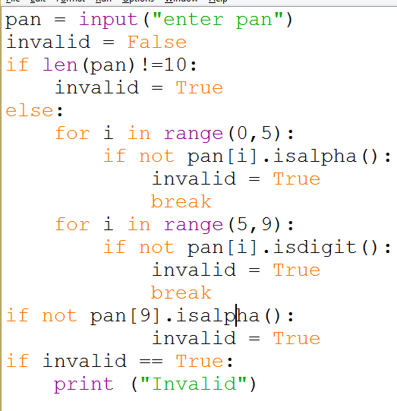

Slide 44
String exercises
Check if the given string is a palindrome or not.
Encrypt a string by adding 3 to the ascii value of each character in the given string.
Hint: ord(), chr()
Decrypt the encrypted string.

